Slide 1
Car-Pooling System
Presented by:
Muhammad shah (22p9153) Shayan Rasool (22p9157)
M.Yamman (22p3000) Nasir razaque (22p9134)

Slide 2
01
Introduction

Slide 3
Overview of Car-Pooling System
The Carpooling System will provide a platform that allows users (drivers and passengers) to find each other and share rides. The document will help the development team understand what the system needs to do, how it should behave, and the standards it must meet.

Slide 4
Car-Pooling System
Material:
SRS Vision and Scope document
Prototype
Use-Case Diagram

Slide 5
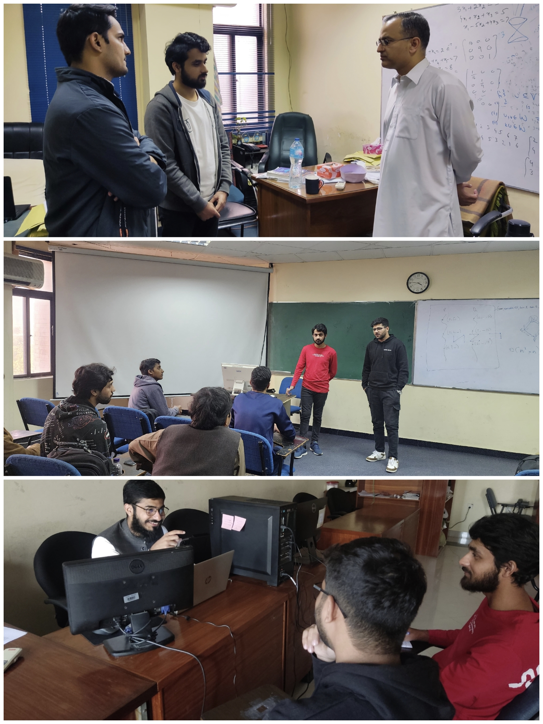

Slide 6
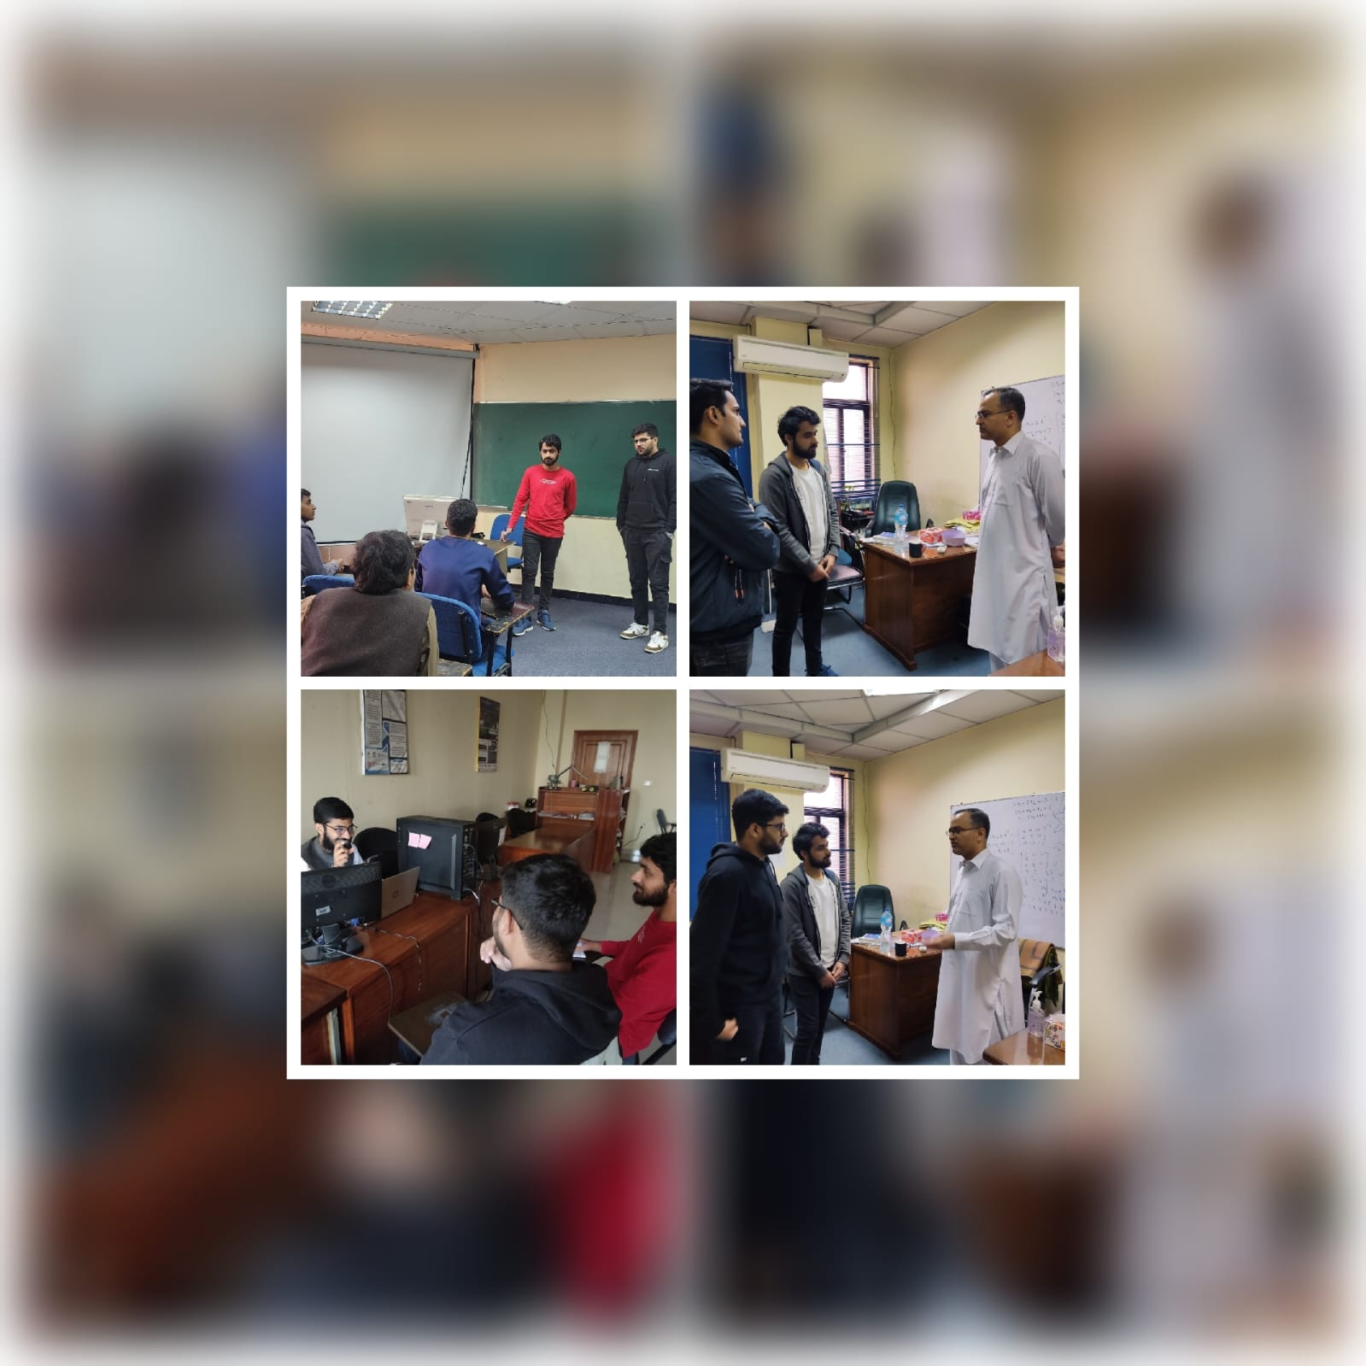

Slide 7
One thing I learned is that stakeholders are like kids in a candy shop—they want everything, but the budget says they can only have one piece!

Slide 8
02
Challenges

Slide 9
Car-Pooling System
Key Challenges in Gathering Requirements
Varying Stakeholder Expectations: Stakeholders, such as students and teachers, have different priorities (e.g., cost vs. comfort).
Miscommunication: Complex technical terms can confuse non-technical stakeholders.
Incomplete Requirements: Stakeholders often fail to provide all the needed details or think of requirements after the session.

Slide 10
We brought all the stakeholders together to make decisions. It felt like a family dinner—everyone had an opinion, but somehow, we got through it.

Slide 11
Requirement elicitation teaches you patience. Like when you explain an idea and someone says, ‘That’s great, but can we make it completely different?

Slide 12
Car-Pooling System
Ambiguity in Defining System Requirements
Lack of Clear Scope: Difficulty in drawing boundaries on what the system will and won’t do. (e.g., Is it a carpool app or a ride-hailing app?).
Unclear Functionalities: Stakeholders may struggle to agree on essential features.
Changing Requirements: Requirements evolve during development, adding unplanned features and impacting timelines.

Slide 13
10
Q&A
Thanks!
Any questions?

